Slide 1
Tellico Village Golf
World Class Golf at a Value
GAC Meeting – May 16th, 2022

Slide 2
Agenda
Welcome & Opening Comments
Approval of April Minutes
Golf Rounds and Financial Report
Program Tracking
Capital Requests
Long-Range Planning
Golf Advisory Committee Updates
Committee Liaisons
2022 Goals and Objectives (Golf History)
Golf Operations Updates – C. Sykes
Golf Cart Policies and Standards
Golf Calendar Highlights
Full Calendar Available on the www.golftellicovillage.com website
Golf Course Updates – Golf Supers
Golf Marketing-Advertising Updates
Other?

Slide 3
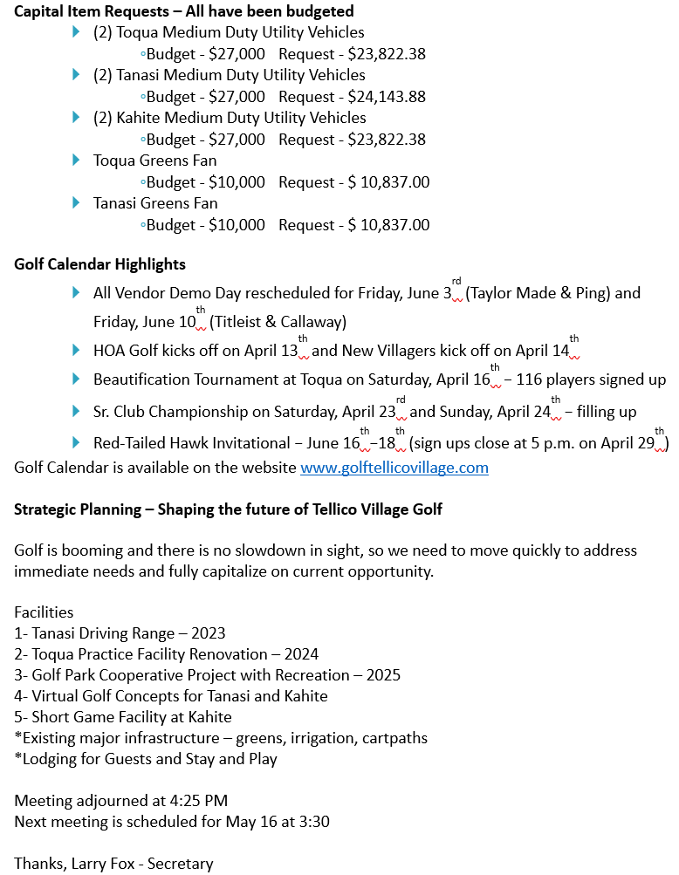
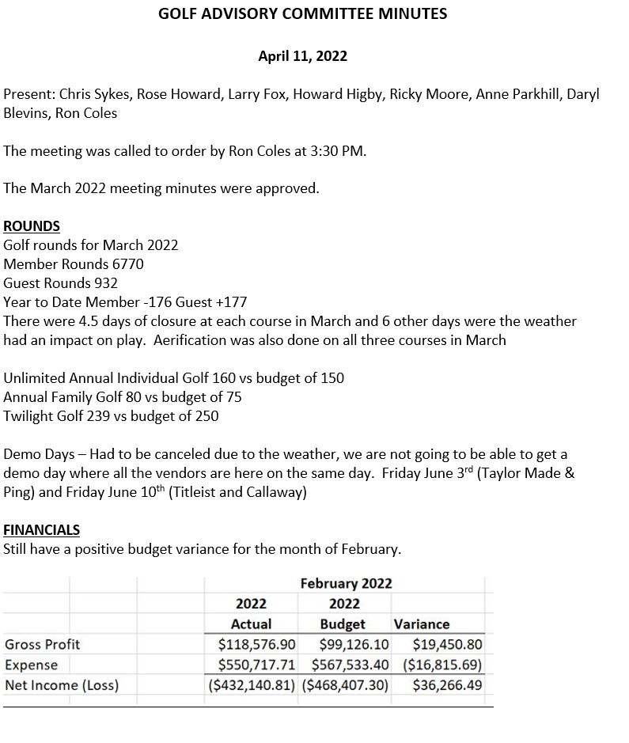
Approval of April Minutes

Slide 4
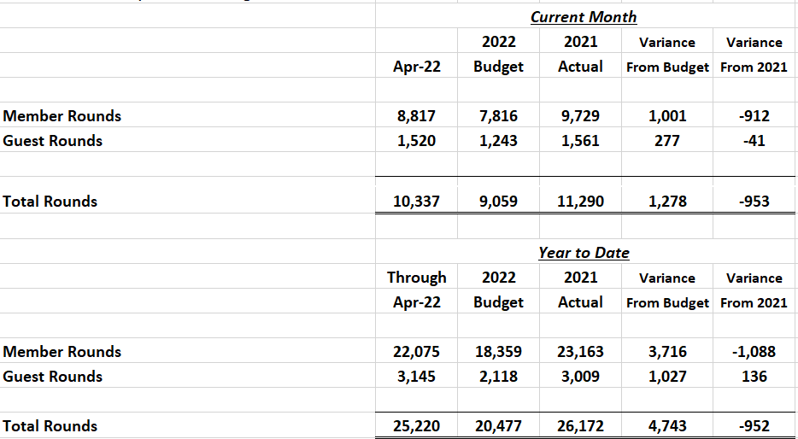
Rounds Report – April 2022
April in 2021 was unusually dry with only 5 rain events and a total of only 1.45”. This April had 8 rain events and a total of 3.38”. Temperatures overall were below average, and we had more days with high wind that I can ever remember. The weather extremes led to 2 unplayable days and 8 days total that were impacted by weather.

Slide 5
Unlimited Package Update

Slide 6
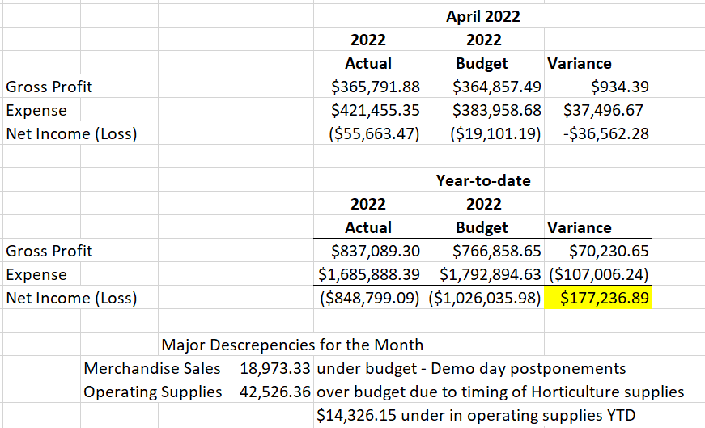
Financial Report – April 2022

Slide 7
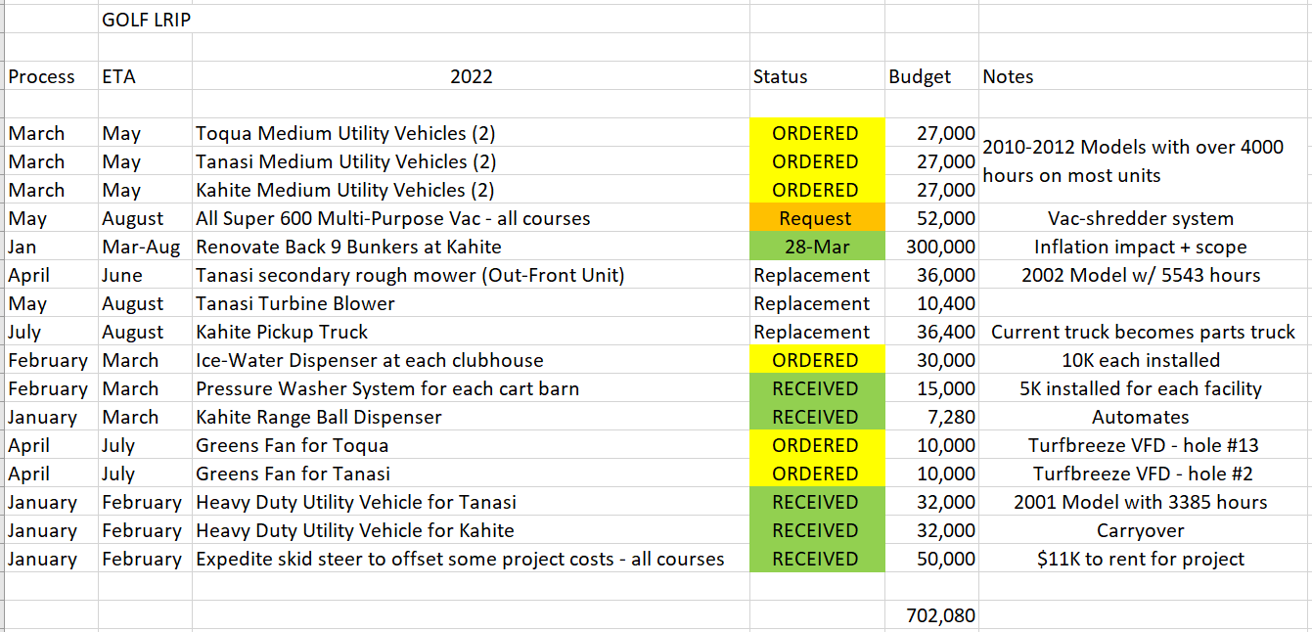
Golf LRIP-Capital for 2022

Slide 8
2022 Capital Project Funding Request – Super 600
Project Description: Wiedenmann Super 600 for shared use by Kahite, Tanasi, and Toqua
Manager: Jon North/Tyler Thies
Budget Amount: $ 50,000
Request Amount: $52,695.44
Source of Funds: Operating Cash
Finance Advisory Committee Approval? TBD
Project Justification: A multi-function pull behind machine that can core collect, verticut, fraze mow, collect leaves/debris and more. This machine will allow for more cultivation processes to be performed on tees, fairways, and roughs at all three courses and greatly speed up cleanup efforts after large storms and during leaf season in the fall.
Sole Source Bid from Greenville $52,695.44
Requested Board of Directors Action: Approve request for purchase and funding from the Operating Cash.

Slide 9
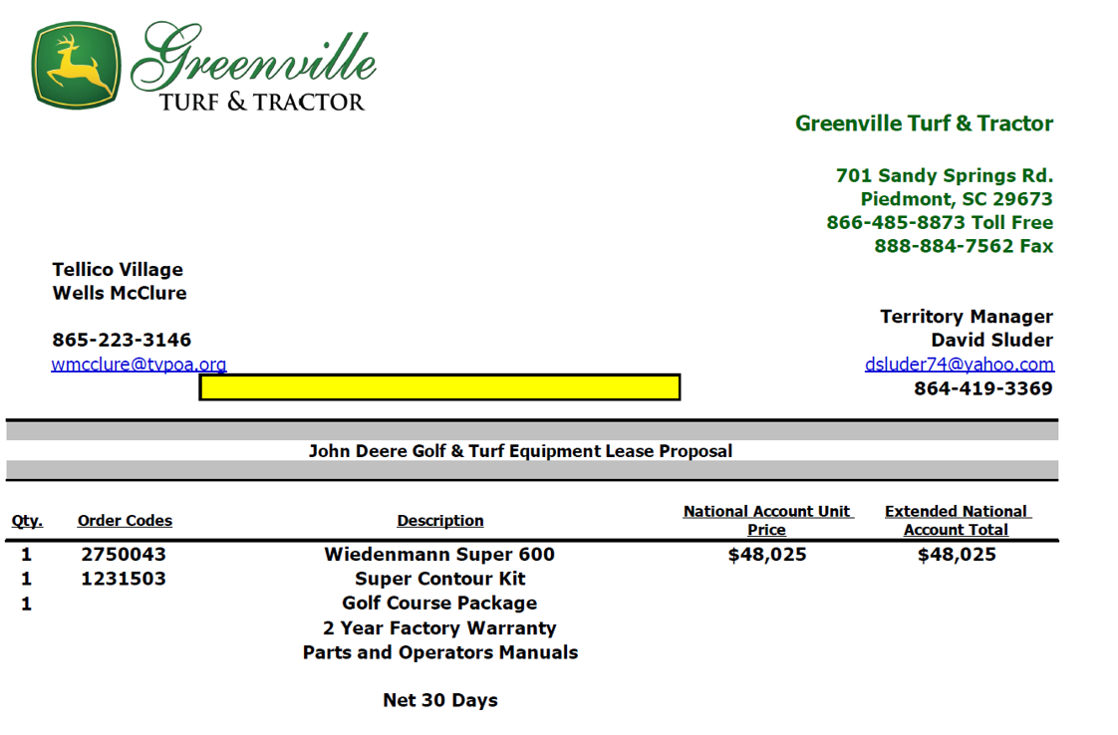

Slide 10
LRPAC Survey – Shaping the Future of Tellico Village Golf
Golf will follow-up with a more detailed survey targeting the golf community.
World Class Golf at a Value – 94% of respondents said golf met or exceeded their expectations.
Waking trails – golf cart paths are our greenways and are used daily for walking, biking and cruising.
Park space – the golf courses are our most beautiful and protected green space. These Audubon Sanctuaries consist of close to 400 acres.
The future of golf will include more technology and outdoor social activities.
The GET facility and Golf Park will address these needs.
$ - ‘Pay It Forward’ Golf Amenity Campaign
Reserves, Borrow from self, Timeless Tellico, Fundraising, Surcharge
CEO Search and BOD Strategic Planning Session
Reserve Study

Slide 11
Strategic Planning – Shaping the future of Tellico Village Golf
Golf is booming and there is no slowdown in sight, so we need to move quickly to address immediate needs and fully capitalize on current opportunity.
Facilities
1- Tanasi Driving Range – 2023
2- Toqua Practice Facility Renovation – 2024
3- Golf Park Cooperative Project with Recreation – 2025
4- Virtual Golf Concepts for Tanasi and Kahite
5- Short Game Facility at Kahite
*Existing major infrastructure – greens, irrigation, cartpaths
*Lodging for Guests and Stay and Play

Slide 12
Golf Advisory Committee
2022 GAC Members
Ron Coles – Chair and FAC Liaison (2023)
Howard Higby – Vice Chair (2024)
Larry Fox – Secretary (2023)
Rose Howard – RAC Liaison (2024)
Daryl Blevins – (2022)
Anne Parkhill – (2023)
Ricky Moore – (2023)
Committee Liaisons
Long-Range Planning (LRPAC) – Howard Higby
Communications (CAC) – Larry Fox
Recreation (RAC) – Rose Howard
THANK YOU FOR YOUR CONTRIBUTIONS AND CONTINUED SUPPORT OF TELLICO VILLAGE GOLF!

Slide 13
Golf Advisory Committee
2022 Goals and Objectives for consideration
Develop a Mission, Vision and Comprehensive Golf Course Value Statement for Golf.
Approve Maintenance Guidelines for Golf Course and Landscape Maintenance Activities.
Work with Golf Management on continuing to improve the overall ‘Golf Experience’ in Tellico Village through programming and golf course improvement efforts.
Establish Golf Cart Policies and Standards
Improve Synergism with F&B as well as other golf partners.
Revamp Hole Location Sheet at Kahite in 2022.
Golf Course Improvement Projects.
Continue to refine LRIP for all areas (Support Golf Projects)
Finalize Business Plan for G.E.T. Facility by end of second quarter of ‘22.
Develop Potential Golf Concept Plans for new CCI property acquisitions.
Complete B9 Bunkers at Kahite
Marketing-Advertising and Communications
Golf History – catalog and develop plans for how to integrate into operations
Strategically target golfers for future Tellico Village Residents
Continue to expand-improve overall communications
Golf Programming
Continue to evaluate and properly position Unlimited Programs
Continue to expand Player Development Programming
Continue to expand non-traditional Golf Opportunities
TEAM
Develop working relationship with Golf Management Team – orientation/ onboarding
BOD and all advisory committee relations
Director of Golf office located at Toqua Golf Maintenance
Office # - 865.310.9621
Mobile # - 865.228.3370
THANK YOU FOR YOUR CONTRIBUTIONS AND CONTINUED SUPPORT OF TELLICO VILLAGE GOLF!

Slide 14
Golf Operations Updates

Slide 18
Golf Cart Policies and Standards
Ron Coles, Howard Higby and Anne Parkhill are working with Golf Management on a comprehensive policy for GAC review.
This will be reviewed by legal and then brought before the GAC for approval this spring. These policies were pulled from dozens of similar properties and consolidated into best format for Tellico Village.
Once approved communications will go out to the entire golf community.
The ‘Solo Cart Fee’ will remain at $5 per 9-holes and the ‘Single Rider’ Fee will be $8.50 for 18-holes, which will be 50% of standard member cart fee moving forward.

Slide 19
Golf Calendar Highlights
Recent
Beautification Tournament raised over $6K
Sr. Club Champions
Senior Flight (55-64) – Jim Kennedy
Super Senior Flight (65-74) – Dan Dent
Legends (75-79) – Joey Joubert
Masters (80 & Up) – Larry Denny
Ladies (55+) – Noi McKay
2022 TGA State 4-Ball Championships – Tellico Village Golf received rave reviews
Senior Champions – Steve Lupear and Tim Pugh
Super-Senior Champions – Danny Green and Tim Dinwiddie
Upcoming
Lions Club Tournament at Toqua on Saturday, May 21st
All Vendor Demo Day rescheduled for Friday, June 3rd
(Taylor Made & Ping) and Friday, June 10th (Titleist & Callaway)
Red-Tailed Hawk Invitational – June 16th – 18th (78 Teams)
Jr. Golf Camp is July 11th – 15th followed by Parent-Child Tournament on July 16th
2022 Calendar is posted on the www.golftellicovillage.com website

Slide 20
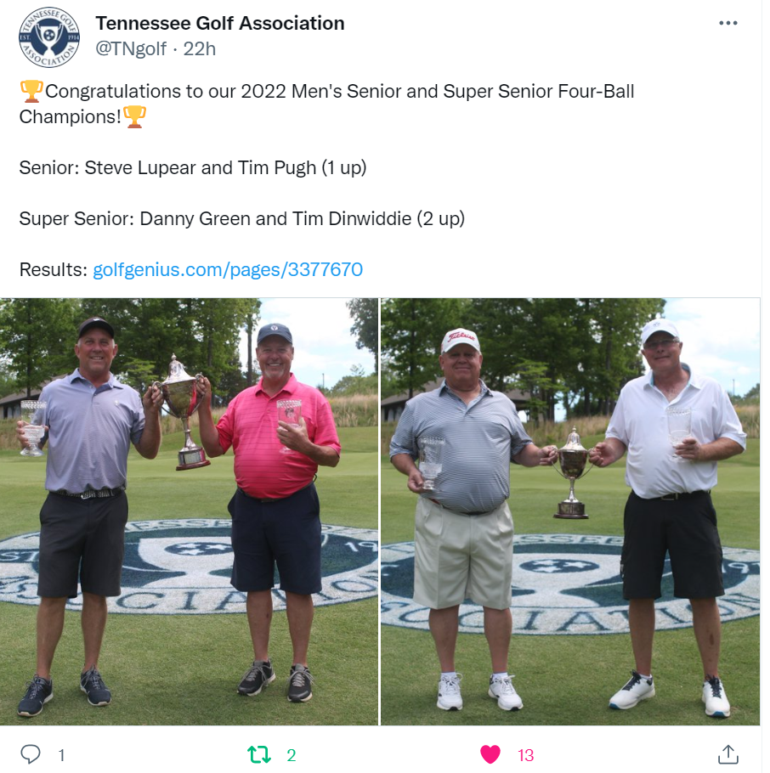
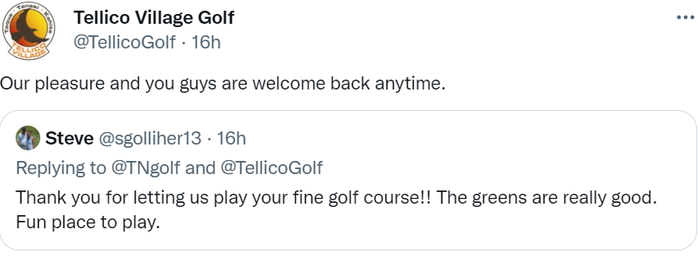

Slide 21
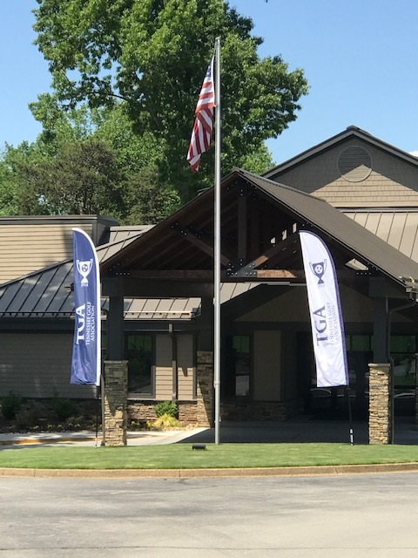
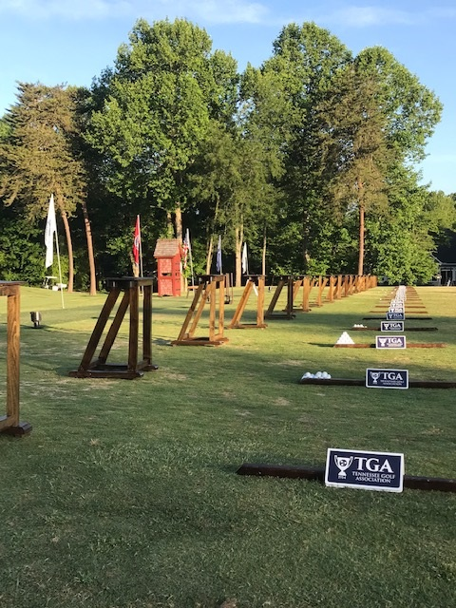
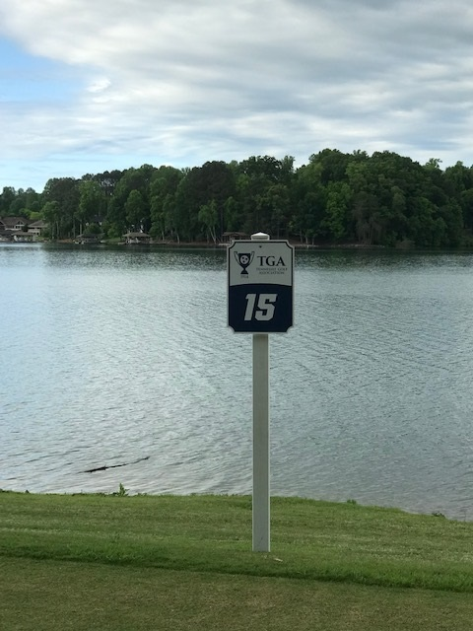
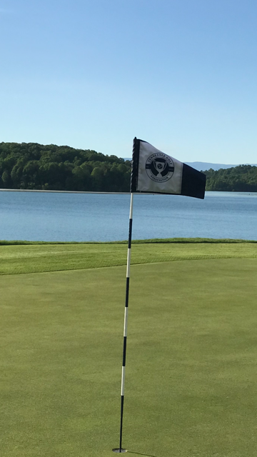
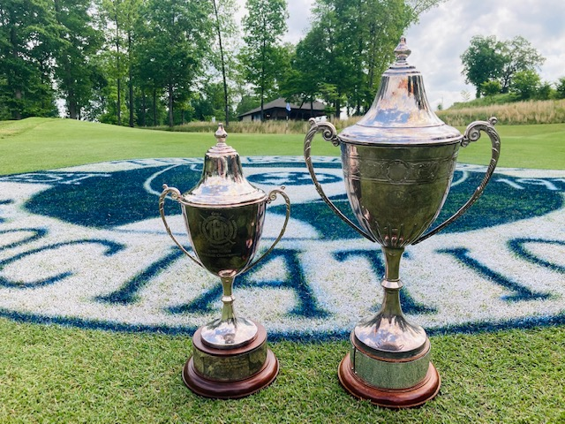

Slide 23
Golf Course Updates

Slide 24
Course Updates
New fan infrastructure has been installed on holes #2, #5, #6 and #13
Fans will start going out onto the course this week as were waiting until after the TGA 4-ball.
New tee on hole #1 is completed and will open in the next couple of weeks.
Putting surfaces are as good as they have ever been so primary focus will be on growing in weak fairway areas.
First Impression – clubgrounds have become a real showplace this spring.

Slide 25
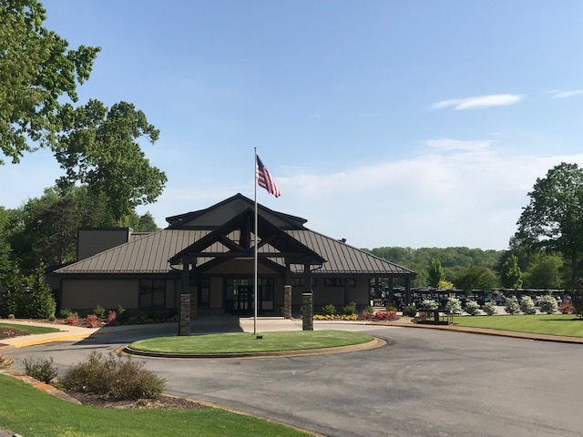
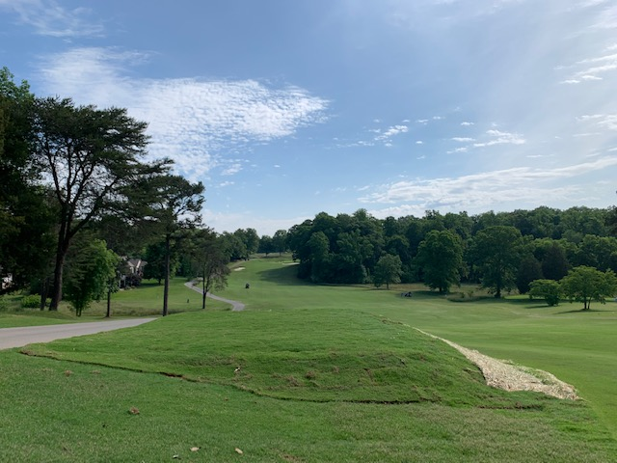
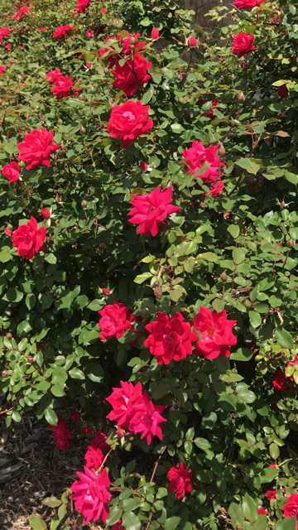

Slide 26
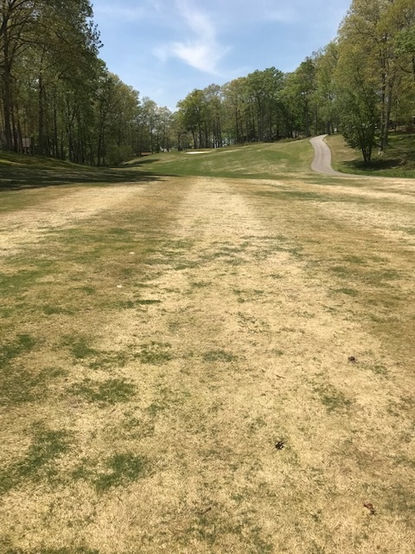
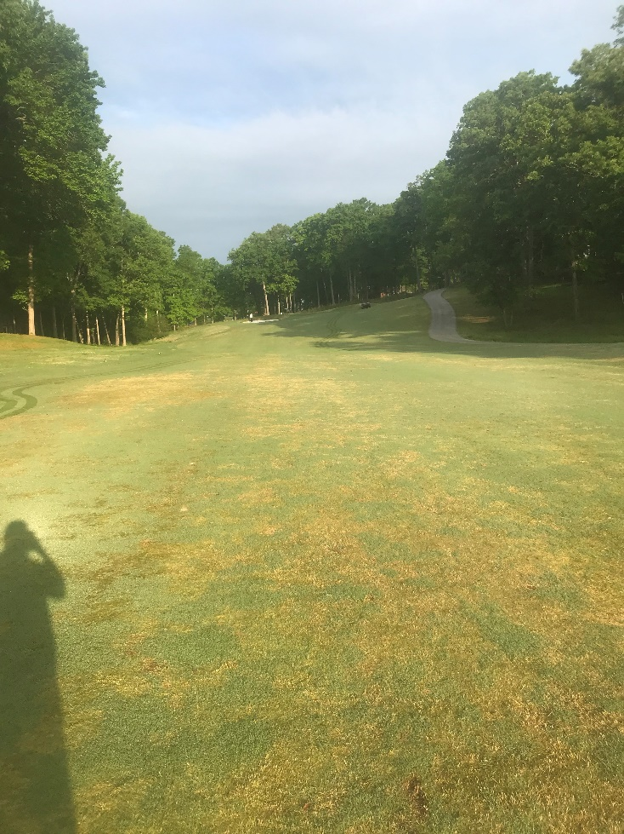
Record Traffic – increased cart traffic has led in an increase in spring dead spot and mini-ring in concentrated wear areas. These areas will all receive additional cultural measures and fertilizer inputs to expedite the healing process. The grow-in process will require controlling cart traffic as well.
#8 Fairway on April 23rd
#8 Fairway on May 3rd

Slide 27
Course Updates
New yellow tee on #10 and renovated-expanded green tee will be sodded this week
Next tee project will be building a new yellow tee by the cartpath on #16
Drainage work is ongoing which includes raising-leveling existing catch basins
Fans will be going out later this month
First Impression – bathroom columns were redone, and numerous clubhouse grounds improvements are ongoing
Cart traffic – increased wear and tear from record rounds is showing including affecting the severity of spring dead spot. These areas will all receive additional cultural measures and fertilizer inputs to expedite the healing process.
Putting surfaces – some drill and fill holes remain but have fully transitioned from grow-in recovery to playability.

Slide 28
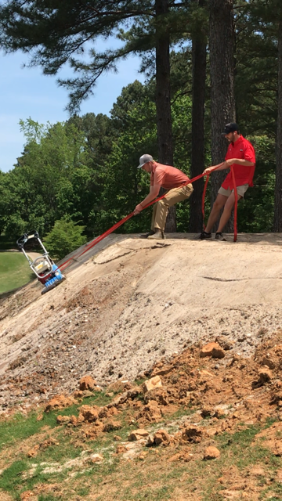
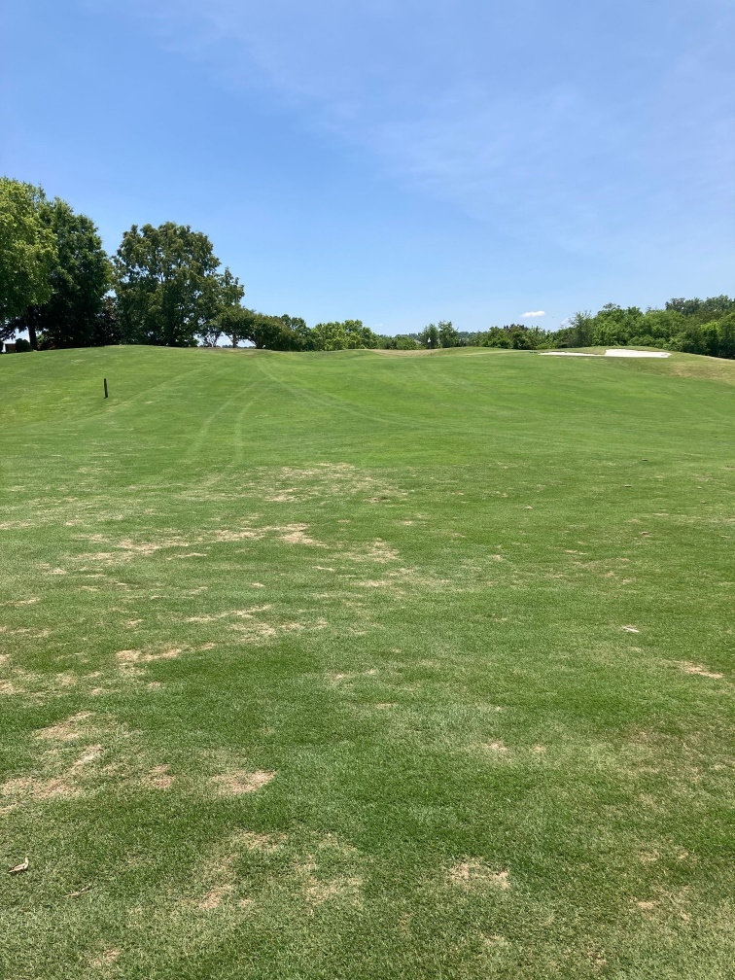

Slide 29
Course Updates
Back 9 Bunker Renovation is sole project focus for the team in addition to day-to-day operations.
#18 should be finalized on Tuesday and plan is to grass on Friday.
#11 is marked so team will move their next and pretty much stay in order from that point forward.

Slide 30
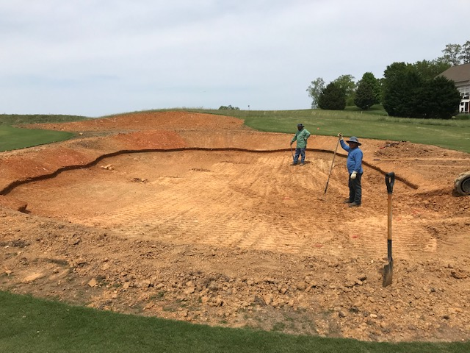
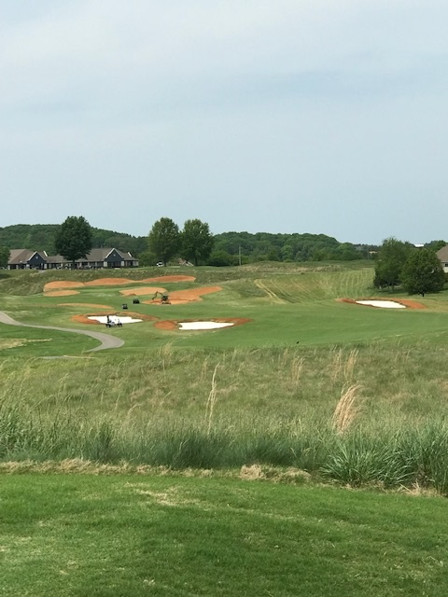
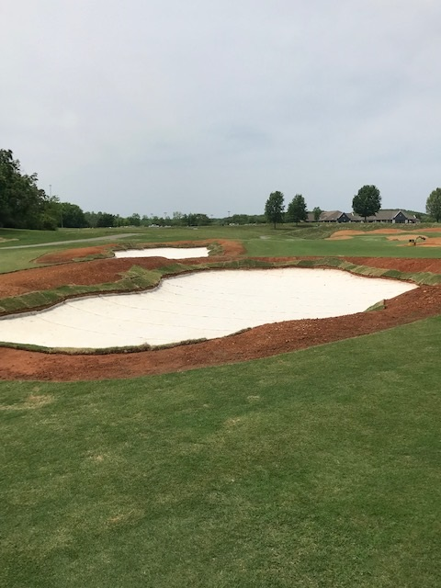
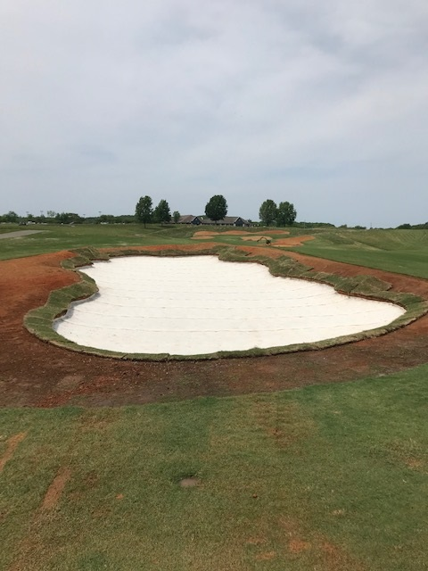
Bunker Project

Slide 31
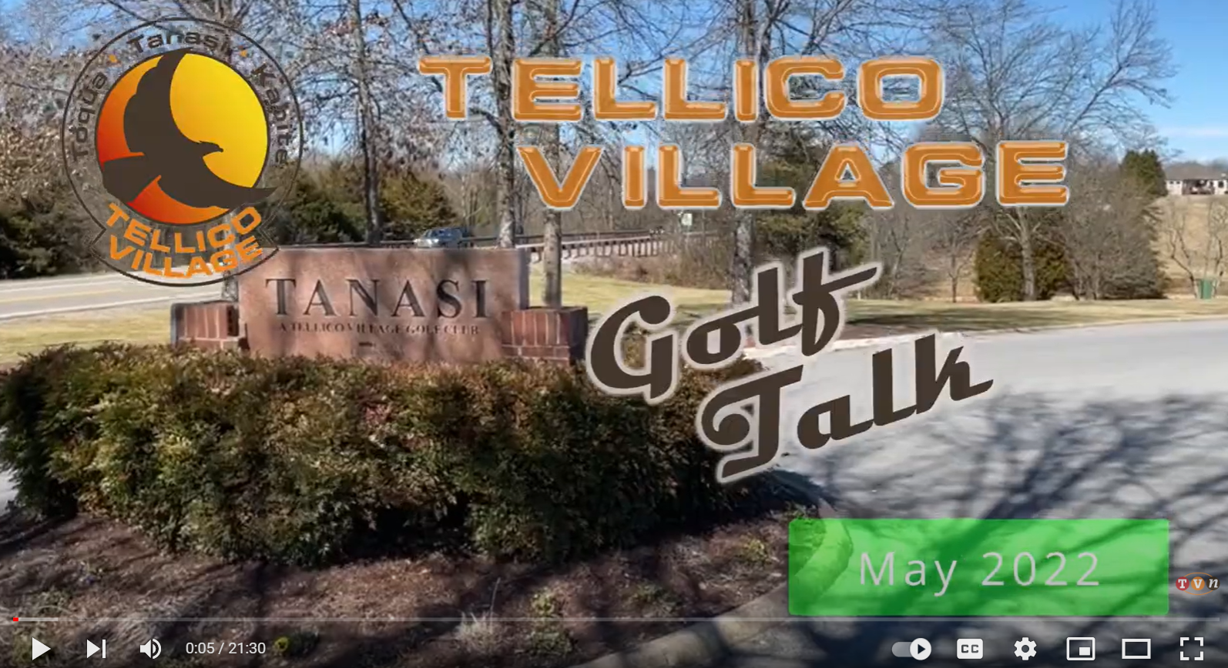
Golf Marketing-Communications
May Golf Talk Episode – will be adding a Len Willis Tribute
2nd Quarter Newsletter in Production
Golf took over ownership of Website

Slide 32
Other business?
Any questions?
Thank you for all your support for Golf in Tellico Village!

