Slide 1
Tellico Village Golf
World Class Golf at a Value
GAC Report – July 11th

Slide 2
Agenda
Welcome & Opening Comments
Approval of June Report with no in-person meeting
Golf Rounds and Financial Report
Program Tracking
Capital Requests Update
2023 Budget Calendar
Long-Range Planning
Golf Advisory Committee Updates
Committee Liaisons
2022 Goals and Objectives
Golf Operations Updates – C. Sykes
Golf Calendar Highlights
Full Calendar on the www.golftellicovillage.com website
Golf Course Updates – Golf Supers
Golf Marketing-Advertising Updates
Golf Ownership of www.golftellicovillage.com website
Other?

Slide 3
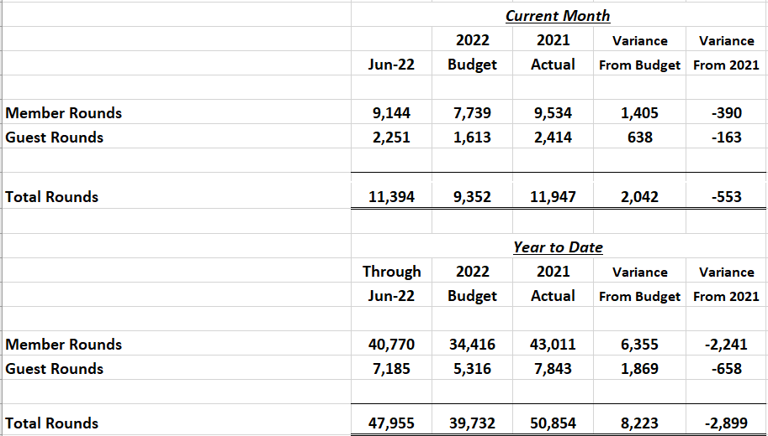
Rounds Report – June 2022
June was a month of extremes. While the month started mild with moderate rain, the last three weeks were brutally hot and dry. The average rain total across all three courses was 3.5” but we had a stretch of over 18 days without rain (almost a month at Kahite).
June was also hot where we recorded 21 days with temperatures above 85 degrees and 14 days above 90 degrees. The worst of the weather overlapped with The Red-Tailed Hawk Invitational when temperatures reached almost 100 degrees.

Slide 4
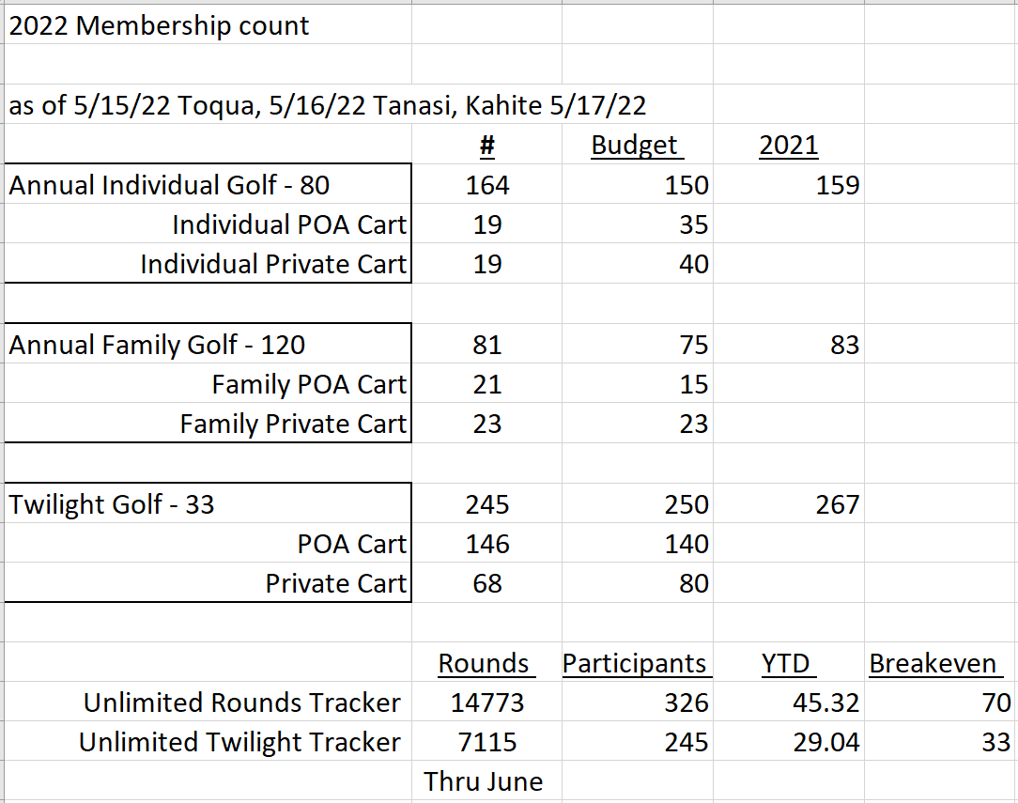
Unlimited Package Update

Slide 5
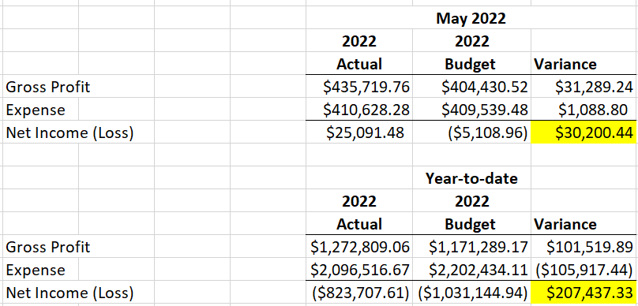
Financial Report – May 2022 ***June Financials should be out this week & will update

Slide 6
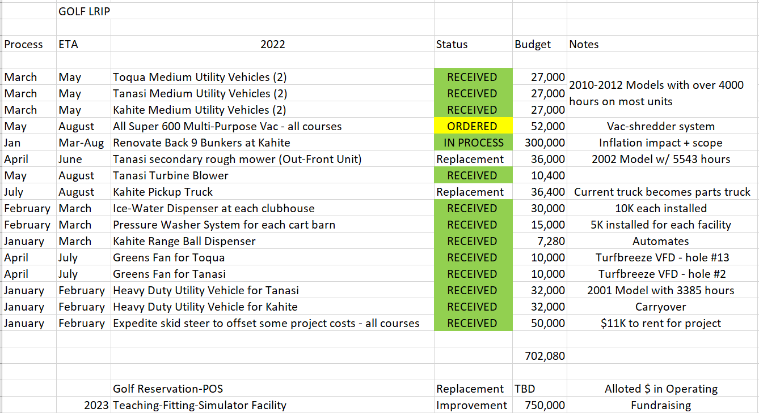
Golf LRIP-Capital for 2022

Slide 8
LRPAC Survey – Shaping the Future of Tellico Village Golf
Golf will follow-up with a more detailed survey targeting the golf community.
World Class Golf at a Value – 94% of respondents said golf met or exceeded their expectations.
Waking trails – golf cart paths are our greenways and are used daily for walking, biking and cruising.
Park space – the golf courses are our most beautiful and protected green space. These Audubon Sanctuaries consist of close to 400 acres.
The future of golf will include more technology and outdoor social activities.
The GET facility and Golf Park will address these needs.
$ - ‘Pay It Forward’ Golf Amenity Campaign
Reserves, Borrow from self, Timeless Tellico, Fundraising, Surcharge
CEO Search and BOD Strategic Planning Session
Reserve Study

Slide 9
Strategic Planning – Shaping the future of Tellico Village Golf
Golf is booming and there is no slowdown in sight, so we need to move quickly to address immediate needs and fully capitalize on current opportunity.
Facilities
1- Tanasi Driving Range – 2023
2- Toqua Practice Facility Renovation – 2024
3- Golf Park Cooperative Project with Recreation – 2025
4- Virtual Golf Concepts for Tanasi and Kahite
5- Short Game Facility at Kahite
*Existing major infrastructure – greens, irrigation, cartpaths
*Lodging for Guests and Stay and Play

Slide 10
Golf Advisory Committee
2022 GAC Members
Ron Coles – Chair and FAC Liaison (2023)
Howard Higby – Vice Chair (2024)
Larry Fox – Secretary (2023)
Rose Howard – RAC Liaison (2024)
Daryl Blevins – (2022)
Anne Parkhill – (2023)
Ricky Moore – (2023)
Committee Liaisons
Long-Range Planning (LRPAC) – Howard Higby
Communications (CAC) – Larry Fox
Recreation (RAC) – Rose Howard
THANK YOU FOR YOUR CONTRIBUTIONS AND CONTINUED SUPPORT OF TELLICO VILLAGE GOLF!

Slide 11
Golf Advisory Committee
2022 Goals and Objectives for consideration
Develop a Mission, Vision and Comprehensive Golf Course Value Statement for Golf.
Approve Maintenance Guidelines for Golf Course and Landscape Maintenance Activities.
Work with Golf Management on continuing to improve the overall ‘Golf Experience’ in Tellico Village through programming and golf course improvement efforts.
Establish Golf Cart Policies and Standards
Improve Synergism with F&B as well as other golf partners.
Revamp Hole Location Sheet at Kahite in 2022.
Golf Course Improvement Projects.
Continue to refine LRIP for all areas (Support Golf Projects)
Finalize Business Plan for G.E.T. Facility by end of second quarter of ‘22.
Develop Potential Golf Concept Plans for new CCI property acquisitions.
Complete B9 Bunkers at Kahite
Marketing-Advertising and Communications
Golf History – catalog and develop plans for how to integrate into operations
Strategically target golfers for future Tellico Village Residents
Continue to expand-improve overall communications
Golf Programming
Continue to evaluate and properly position Unlimited Programs
Continue to expand Player Development Programming
Continue to expand non-traditional Golf Opportunities
TEAM
Develop working relationship with Golf Management Team – orientation/ onboarding
BOD and all advisory committee relations
Director of Golf office located at Toqua Golf Maintenance
Office # - 865.310.9621
Mobile # - 865.228.3370
THANK YOU FOR YOUR CONTRIBUTIONS AND CONTINUED SUPPORT OF TELLICO VILLAGE GOLF!

Slide 12
Golf Operations Updates

Slide 15
Golf Calendar Highlights
Recent
Red-Tailed Hawk Invitational – June 16th – 18th
Historic Hole in Ones
LGA18 Member-Guest was at Toqua on Monday, June 20th
LGA9 Guest Day was at Toqua on Tuesday, June 28th
Smoky Mountain Service Dogs outing was at Toqua on Saturday, June 25th
Demo Days have all been a huge success
TPI Sessions have been very well received and there are more scheduled
Upcoming
Jr. Golf Camp is July 11th – 15th followed by Parent-Child Tournament on July 16th (65 campers registered)
2022 Calendar is posted on the www.golftellicovillage.com website

Slide 16
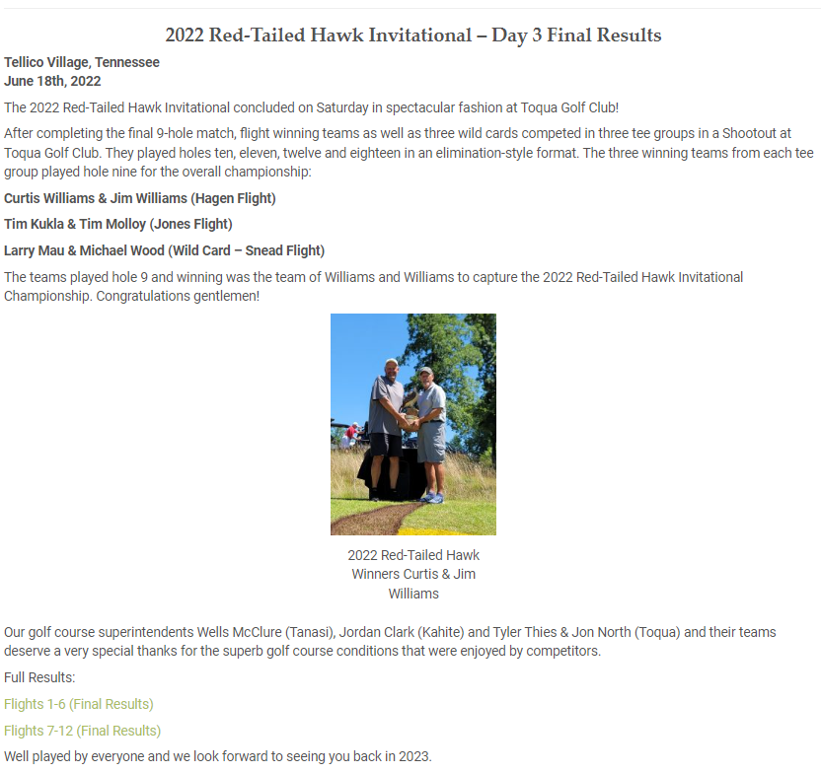

Slide 21
Golf Course Updates

Slide 22
Course Updates
Ice Water Station Installed outside of Golf Shop
All fans are out for the season, which includes the larger NEW Turfbreeze fans on the PG, #3 and #5. We were able to repurpose the older Turfbreeze fans to better support holes #6 and #13.
New Yellow Tee on hole #1 is now open for play.
Toqua Parking Lot paving project was completed, which includes a new golf cart return that will be rolled out in the coming weeks.
Putting surfaces are as good as they have ever been for this time of year in spite of some very difficult weather conditions.
The golf course has never been better and showed very well for recent state events and The Red-Tailed Hawk Invitational.
Team is in flux but still well positioned for the season.

Slide 23
Course Updates
Ice Water Station Installed at turn shack
The new yellow tee on #10 and renovated-expanded green tee are both open for play.
New yellow tee for #16 has been constructed and will be sodded next week.
Drainage work for #15 and #16 fairways is next, which will create more dirt for additional tee improvements (#15).
Putting surfaces are as good as they have ever been for this time of year in spite of some very difficult weather conditions.
New fan on #2 is a big improvement and should lessen pressures.
Team is in flux but still well positioned for the season.

Slide 24
Course Updates
Bunker Renovation is primary focus in addition to day-to-day operations.
#18, #11 and #12 are grown-in and fully open
#13 and #14 are in finishing stage and should be completed in next two weeks
New Yellow Tee on #3 is a great addition and has had an immediate positive impact on playability (excess dirt for additional tee work on #12 and #13)
#15 - #17 have been marked for construction
Putting surfaces are as good as they have ever been for this time of year in spite of some very difficult weather conditions.
Golf Course Maintenance Team is hanging on tough and the course are very well positioned for the remainder of the season
Ice Water Station Installed beside restaurant walk-up window

Slide 25
Golf Marketing-Communications
Golf Talk – will be revamping programming while we look for a new co-host
Tellico Pride – will be filming independent course care videos
2nd Quarter Newsletter had a large golf presence
Golf took over ownership of Website – Lucas Forstrom is the new managing editor

Slide 26
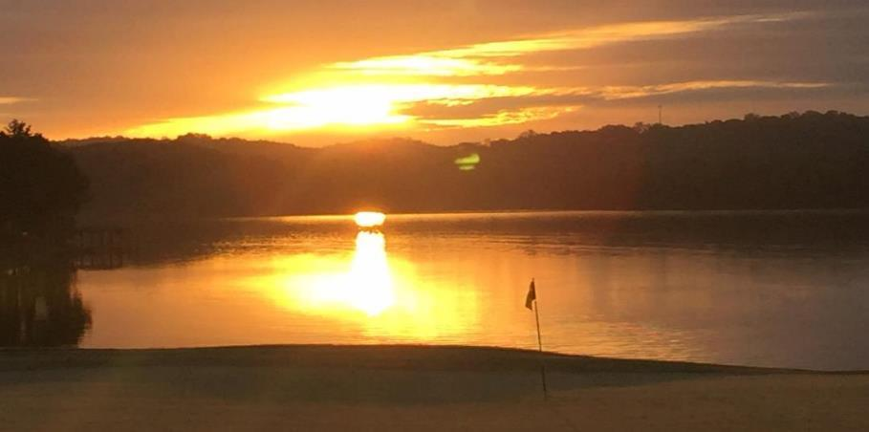
Other business?
Dress T-Shirts?
Solo Carts
Private Carts in restricted areas
Walk paths for motorized push carts
Any questions?
Thank you for all your support for Golf in Tellico Village!

