Slide 1
Tellico Village Golf
World Class Golf at a Value
GAC Report – October 3rd

Slide 2
Agenda
Welcome & Opening Comments
Golf Rounds Report
Financial Report
September-YTD Financials
Program Tracking
2023 Budget Update – FAC/BOD – October 17th–18th
CapEx
Expenses
Rounds
Rates
Golf Advisory Committee Updates
Committee Liaisons
2022 Goals and Objectives
Golf Operations Updates – C. Sykes
Tanasi Golf Restoration Update
Golf Calendar Highlights
Full Calendar on the www.golftellicovillage.com website
Golf Course Updates – Golf Supers
Golf Marketing-Advertising Updates
Golf Ownership of www.golftellicovillage.com website
Other?

Slide 3
Rounds Report – September 2022
September was an incredible month for golf with mild temps and very little rain. There were only 5 days with temps above 85 degrees compared to 2019 when there were 28. We only recorded 1.79” of rain at Toqua, which is the lowest we have experienced since 2015. Excellent course conditions and near perfect weather for golf helped overcome the reduced capacity we are currently managing at Tanasi.
 | Current Month
 |  | 2022 | 2021 | Variance | Variance
 | Sep-22 | Budget | Actual | From Budget | From 2021
Member Rounds | 8,663 | 7,576 | 8,982 | 1,087 | -320
Guest Rounds | 1,511 | 1,381 | 1,834 | 130 | -323
Total Rounds | 10,174 | 8,957 | 10,816 | 1,217 | -642
 | Year to Date
 | Through | 2022 | 2021 | Variance | Variance
 | Sep-22 | Budget | Actual | From Budget | From 2021
Member Rounds | 69,401 | 57,642 | 71,393 | 11,759 | -1,992
Guest Rounds | 12,940 | 9,633 | 13,988 | 3,307 | -1,048
Total Rounds | 82,341 | 67,275 | 85,381 | 15,066 | -3,040

Slide 4
Unlimited Package Update
2022 Membership count
 | # | Budget | 2021
Annual Individual Golf - 80 | 164 | 150 | 159
Individual POA Cart | 19 | 35
Individual Private Cart | 19 | 40
Annual Family Golf - 120 | 81 | 75 | 83
Family POA Cart | 21 | 15
Family Private Cart | 23 | 23
Twilight Golf - 33 | 260 | 250 | 267
POA Cart | 146 | 140
Private Cart | 68 | 80
 | Rounds | Participants | YTD | Breakeven
Unlimited Rounds Tracker | 22764 | 326 | 69.83 | 70
Unlimited Twilight Tracker | 9864 | 260 | 37.94 | 33
 | Thru Sept

Slide 5
Financial Report – September 2022
 |  |  |  | September 2022
 |  |  |  | 2022 | 2022
 |  |  |  | Actual | Budget | Variance
Gross Profit |  |  |  | $451,203.37 | $355,769.07 | $95,434.30
Expense |  |  |  | $476,576.50 | $439,303.69 | $37,272.81
Net Income (Loss) |  |  |  | ($25,373.13) | ($83,534.62) | $58,161.49
 |  |  |  |  | Year-to-date
 |  |  |  | 2022 | 2022
 |  |  |  | Actual | Budget | Variance
Gross Profit |  |  |  | $2,585,108.13 | $2,277,256.51 | $307,851.62
Expense |  |  |  | $3,425,933.13 | $3,566,002.49 | ($140,069.36)
Net Income (Loss) |  |  |  | ($840,825.00) | ($1,288,745.98) | $447,920.98
 |  | September Highlights
 | Disaster Expense & Recovery |  |  | $59,299.22 | Tanasi Fire Loss
 | Member Revenue |  |  | $39,160.84 | Over budget
 | Daily Cart Revenue |  |  | $17,373.33 | Over budget
 | Annual Cart Revenue |  |  | $19,256.07 | Over budget
 | Merchandise Sales |  |  | $15,888.74 | Over budget

Slide 6
2023 Budget – CapEx
GOLF LRIP
2023 CapEx | Budget
Tanasi Driving Range Project | 750,000
Tanasi Range Ball Picker | 15,300
Tanasi Range Ball Machine | 10,200
Tanasi Range Ball Washer | 5,100
Toqua Riding Greensmowes - 2 (JD2550E) | 122,400
Toqua Light Duty Utility Vehicles (Carry-alls) | 25,500
Toqua Pickup Truck (F-150) | 45,900
Toqua Greens Fans - 3 | 33,000
Tanasi Turbine Blower (Buffalo) | 10,400
Tanasi Greens Fan | 11,220
Kahite Trim Mower | 61,200
Kahite Small Primary Rough Mower | 51,000
Kahite Greens Spray Rig | 51,000
Kahite Nursery Green | 50,000
Kahite Golf Pro Shop Furnishings | 10,000
 | 1,252,220

Slide 7
2023 Budget – Inflation Analysis
Budget-Inflation-Rate Analysis
 | Inflation %
Expense
Salaries & Wages | 6.5%
Benefits | 10.0%
Personnel | 5.9%
Material & Supply | 5.9%
Operating Supplies
Small Tools & Eq | 5.9%
Horticulture | 20.0%
Maintenance | 5.9%
Housekeeping | 5.9%
Range | 5.9%
ProShop | 5.9%
Gasoline | $4.50
Diesel | $4.60
Maintenance Expense | 5.9%
Services | 5.9%
Utility | 15.0%
Taxes, License & Insurance | 5.9%
Banking | 5.9%
Rental | 5.9%
General | 5.9%
Depreciation | 5.9%
Costs of Merchandise | 5.9%
 | 11.9%
 | 8.9%
 | 448440

Slide 8
2023 Budget – Rounds Forecasting
2022 Rounds Forecast (YTD + Budgeted)
Total Member Rounds – 85,221
Total Guest Rounds – 15,211
Total Rounds – 100,432
Member Rounds | Jan-22 | Feb-22 | Mar-22 | Apr-22 | May-22 | Jun-22 | Jul-22 | Aug-22 | Sep-22 | Oct-22 | Nov-22 | Dec-22
 | 22A | 22A | 22A | 22A | 22A | 22A | 22A | 22A | 22A | 22B | 22B | 22B
Toqua | 919 | 1,671 | 2,632 | 3,234 | 3,441 | 3,163 | 3,477 | 3,927 | 3,483 | 2,660 | 2,176 | 1,129 | 31,912
Tanasi | 834 | 1,518 | 2,295 | 2,921 | 3,353 | 3,246 | 3,217 | 3,554 | 2,608 | 2,521 | 1,951 | 1,056 | 29,074
Kahite | 542 | 1,006 | 1,843 | 2,662 | 2,759 | 2,735 | 2,615 | 3,180 | 2,572 | 1,774 | 1,774 | 773 | 24,235
Subtotal Member Rounds | 2,295 | 4,195 | 6,770 | 8,817 | 9,553 | 9,144 | 9,309 | 10,661 | 8,663 | 6,955 | 5,901 | 2,958 | 85,221
Guest Rounds | Jan-22 | Feb-22 | Mar-22 | Apr-22 | May-22 | Jun-22 | Jul-22 | Aug-22 | Sep-22 | Oct-22 | Nov-22 | Dec-22
Toqua | 66 | 141 | 304 | 466 | 570 | 730 | 838 | 574 | 534 | 365 | 234 | 104 | 4,926
Tanasi | 79 | 173 | 306 | 545 | 692 | 740 | 794 | 583 | 378 | 442 | 234 | 130 | 5,096
Kahite | 60 | 175 | 323 | 510 | 528 | 781 | 712 | 746 | 600 | 411 | 205 | 138 | 5,189
Subtotal Guest Rounds | 205 | 489 | 933 | 1,521 | 1,790 | 2,251 | 2,344 | 1,903 | 1,512 | 1,218 | 673 | 372 | 15,211
Total Rounds | Jan-22 | Feb-22 | Mar-22 | Apr-22 | May-22 | Jun-22 | Jul-22 | Aug-22 | Sep-22 | Oct-22 | Nov-22 | Dec-22
Toqua | 985 | 1,812 | 2,936 | 3,700 | 4,011 | 3,893 | 4,315 | 4,501 | 4,017 | 3,025 | 2,410 | 1,233 | 36,838
Tanasi | 913 | 1,691 | 2,601 | 3,466 | 4,045 | 3,986 | 4,011 | 4,137 | 2,986 | 2,963 | 2,185 | 1,186 | 34,170
Kahite | 602 | 1,181 | 2,166 | 3,172 | 3,287 | 3,516 | 3,327 | 3,926 | 3,172 | 2,185 | 1,979 | 911 | 29,424
Subtotal Guest Rounds | 2,500 | 4,684 | 7,703 | 10,338 | 11,343 | 11,395 | 11,653 | 12,564 | 10,175 | 8,173 | 6,574 | 3,330 | 100,432

Slide 9
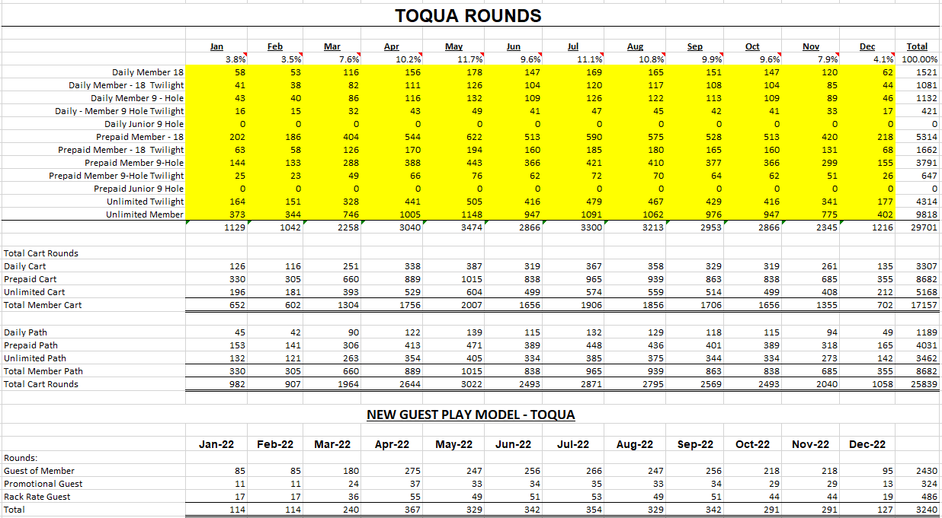
2023 Budget – Rounds Forecasting
2023 Rounds Forecast
Total Member Rounds – 80,000
Total Guest Rounds – 10,000 (6000 Guest of Member, 2000 Promo & 2000 Rack)
Total Rounds – 90,000

Slide 10
2023 Budget – Peer Benchmarking
Peer Clubs include Rarity Bay, WindRiver, Willow Creek, Fairfield Glade and others
Minimum average increase is 5-6% or 2-$3 on daily fees
Fairfield going up $2 across the board on all member rates and $3 on all guest rates
WindRiver is going up $10 pretty much across the board following greens renovation project. 15-20% on daily fees and 20% on memberships.
Sample Guest Rack Rates:
Fairfield Glade
Stonehenge - $83
Other courses - $75
WindRiver - $74 weekend and holiday
Willow Creek - $65 weekend and holiday
Egwani Farms - $55 weekend and holiday
Tellico Village Summary Recommendations:
Member Daily Fees – 4-5% increase
Guest Daily Fees – approx. 8% increase
Unlimited Individual Breakeven – remains at 80
Unlimited Two-Person Breakeven – remains at 120
Unlimited Twilight Breakeven – slight increase from 33-36

Slide 11
Golf Advisory Committee
2022 GAC Members
Ron Coles – Chair and FAC Liaison (2023)
Howard Higby – Vice Chair (2024)
Larry Fox – Secretary (2023)
Rose Howard – RAC Liaison (2024)
Daryl Blevins – (2022)
Anne Parkhill – (2023)
Ricky Moore – (2023)
Committee Liaisons
Long-Range Planning (LRPAC) – Howard Higby
Communications (CAC) – Larry Fox
Recreation (RAC) – Rose Howard
THANK YOU FOR YOUR CONTRIBUTIONS AND CONTINUED SUPPORT OF TELLICO VILLAGE GOLF!

Slide 12
Golf Advisory Committee
2022 Goals and Objectives for consideration
Develop a Mission, Vision and Comprehensive Golf Course Value Statement for Golf.
Approve Maintenance Guidelines for Golf Course and Landscape Maintenance Activities.
Work with Golf Management on continuing to improve the overall ‘Golf Experience’ in Tellico Village through programming and golf course improvement efforts.
Establish Golf Cart Policies and Standards
Improve Synergism with F&B as well as other golf partners.
Revamp Hole Location Sheet at Kahite in 2022.
Golf Course Improvement Projects.
Continue to refine LRIP for all areas (Support Golf Projects)
Finalize Business Plan for G.E.T. Facility by end of second quarter of ‘22.
Develop Potential Golf Concept Plans for new CCI property acquisitions.
Complete B9 Bunkers at Kahite
Marketing-Advertising and Communications
Golf History – catalog and develop plans for how to integrate into operations
Strategically target golfers for future Tellico Village Residents
Continue to expand-improve overall communications
Golf Programming
Continue to evaluate and properly position Unlimited Programs
Continue to expand Player Development Programming
Continue to expand non-traditional Golf Opportunities
TEAM
Develop working relationship with Golf Management Team – orientation/ onboarding
BOD and all advisory committee relations
Director of Golf office located at Toqua Golf Maintenance
Office # - 865.310.9621
Mobile # - 865.228.3370
THANK YOU FOR YOUR CONTRIBUTIONS AND CONTINUED SUPPORT OF TELLICO VILLAGE GOLF!

Slide 13
Golf Operations Updates

Slide 14
Tanasi Clubhouse Bridge Solutions

Slide 15
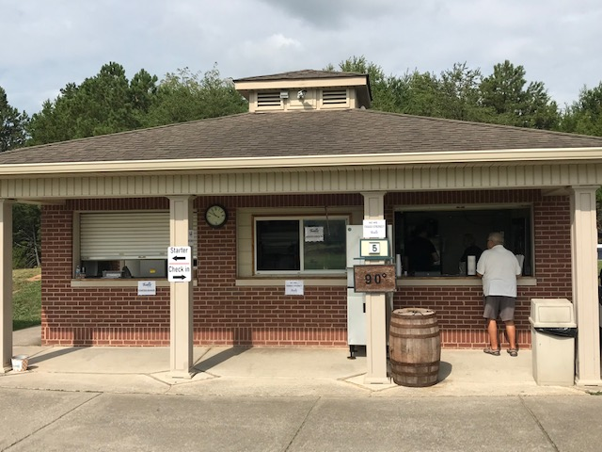
Tanasi Clubhouse Turn Shack - Short-Term Temporary Solution ‘22 Golf Season concludes end of October Spring Green Aeration Closure week of March 20th – 23rd

Slide 16
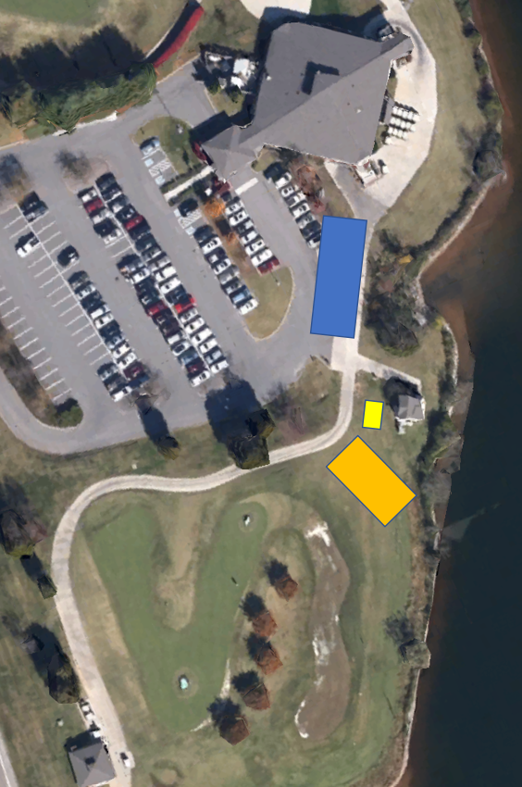

Slide 17
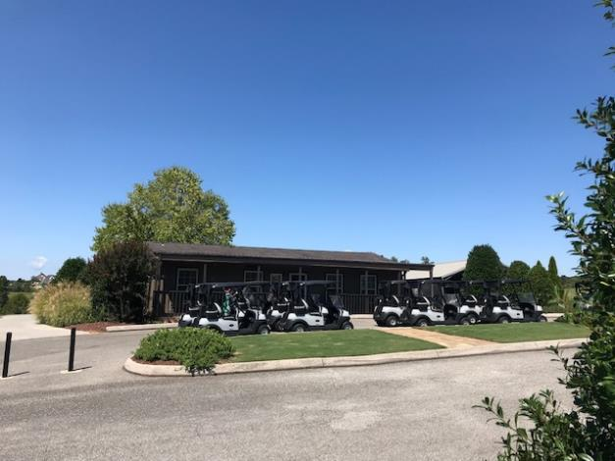
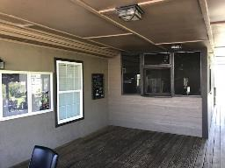
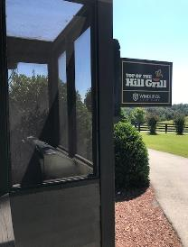
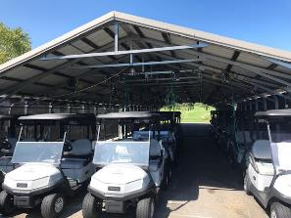
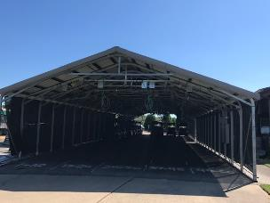
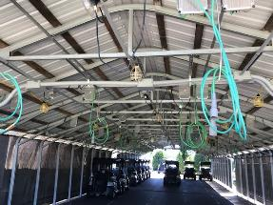

Slide 19
Golf Calendar Highlights
Recent
Kiwanis Tournament was at Toqua on Saturday, September 3rd
Fall DryJect Aeration – tremendous success and greens have all fully recovered
Tanasi – Tuesday, September 6th
Toqua – Wednesday, September 7th
Kahite – Thursday, September 8th
LGA18 Lake Tellico Challenge was on Wednesday, September 21st
Folds of Honor Golf Exhibition was at Toqua on Tuesday, September 20th
MGA Member-Member was on Saturday, October 1st – Sunday, October 2nd
All league play remains strong
Upcoming
MGA Lake Tellico Challenge at Toqua on Friday, October 14th
Average First Frost is October 27th and First Freeze is November 6th
Daylight Savings Time Ends on Sunday, November 6th
2022 Calendar is posted on the www.golftellicovillage.com website

Slide 20
Golf Course Updates

Slide 21
Golf Marketing-Communications
Golf Talk – will be revamping programming while we look for a new co-host
Tellico Pride – course care videos are on the website
2nd Quarter Newsletter has a large golf presence
Golf took over ownership of Website – Lucas Forstrom is the new managing editor

Slide 22
Other business?
Any questions?
Thank you for all your support for Golf in Tellico Village!

